Slide 1

NEUROTONE LABS | AI FOR MENTAL HEALTH INSIGHTS
MENTAL HEALTH
PREDICTION SYSTEM
AI-powered mental health assessment using behavioral and physiological data
GROUP MEMBERS
225066521
H.Z Baloyi
223781673
T.Z Sibiya
240793439
A.L Ndlovu
240223195
M.S Mamba
ACADEMIC PROJECT PRESENTATION • WORKING DRAFT

Slide 2
INTRODUCTION
Project overview
A machine-learning system designed to classify mental health status from structured behavioral and physiological features.
The model uses a 1D Convolutional Neural Network (CNN) and a dataset described as containing 4,000 samples.
The system predicts one of four categories: Healthy, Mild Stress, Moderate Stress, or Severe Stress.
It returns a predicted category together with confidence probabilities for the classes.
01 • NEUROTONE LABS

Slide 3
THEORY
Problem definition
Manual mental health assessment can be time-consuming and subjective.
Affordable assessment tools and specialist systems are not equally accessible in all settings.
Proprietary software, specialized hardware, and limited expertise can create barriers for small research groups and startups.
An automated tool may support research workflows and healthcare decision-support processes.
02 • NEUROTONE LABS

Slide 4
THEORY
Project aim and business objectives
Develop an accessible model for predicting mental health status from the supplied multimodal feature dataset.
Reduce the time required to process structured assessment features.
Provide predictions with class probabilities to support transparent review.
Keep computational requirements modest and support offline prediction after training.
Make the approach usable in academic institutions, startups, and resource-limited settings.
03 • NEUROTONE LABS

Slide 5
THEORY
Proposed AI solution
Use a 1D CNN to learn patterns across 21 structured input features.
Preprocess the data using median imputation and standardization, as described in the project materials.
Train the model on labeled examples and evaluate its predictions on a held-out test set.
Provide a command-line workflow with separate training and prediction modes.
04 • NEUROTONE LABS

Slide 6
THEORY
Dataset and input features
Dataset: mental_health_multimodal.csv; 4,000 samples are reported in the project materials.
21 input features: 3 scores (Depression, Anxiety, Stress) and 18 behavioral/physiological measures.
Examples include sleep quality, social engagement, app usage, typing speed, facial-expression measures, speech features, heart rate, HRV, skin temperature, and GSR.
Target column: Mental_Health_Status, with four expected classes.
05 • NEUROTONE LABS

Slide 7
THEORY
System workflow
1. Load the CSV dataset and clean column names.
2. Validate that the target and all required feature columns are present.
3. Prepare the feature data, split it into training, validation, and test sets, and preprocess it.
4. Train the 1D CNN and monitor validation performance.
5. Save the trained model and preprocessing object; use prediction mode to classify selected rows.
06 • NEUROTONE LABS

Slide 8
THEORY
1D CNN model design
The code screenshots show a Sequential Keras model that accepts the feature input shape.
The first Conv1D block uses 64 filters, a kernel size of 3, ReLU activation, and same padding.
Batch normalization, max pooling, and dropout are used in the model architecture.
A second Conv1D block uses 128 filters, followed by batch normalization and dropout.
The visible code then flattens the learned representation and adds a dense layer.
07 • NEUROTONE LABS

Slide 9
THEORY
Functional requirements
Accept feature data through CSV files or structured arrays.
Preprocess inputs using the configured imputation and scaling steps.
Predict one of the four defined mental health status categories.
Generate prediction output with confidence scores/probabilities.
Support row-level prediction and batch processing.
08 • NEUROTONE LABS

Slide 10
THEORY
Non-functional requirements
Process multiple data points efficiently on standard computing hardware.
Remain portable and usable without a specialized GPU.
Support offline operation after the model has been trained.
Provide clear reports and visualizations for model evaluation.
Expose a simple command-line interface and programmatic workflow.
09 • NEUROTONE LABS

Slide 11
THEORY
Constraints, risks and responsible use
The current scope is structured/tabular data; it does not directly analyze raw text, video, or audio.
The supplied project notes identify dataset bias, possible label leakage, and limited real-world predictive signal as risks.
Misclassification and over-reliance are mitigated through confidence scores, class probabilities, warnings, and clear documentation.
This is an experimental machine-learning evaluation, not a clinical assessment or a replacement for professional judgment.
Important: model performance on this dataset does not establish real-world clinical validity.
10 • NEUROTONE LABS

Slide 12
THEORY
Scalability and future development
Expand evaluation using validated real-world datasets and assess performance across different populations.
Investigate longitudinal monitoring and additional multimodal data sources.
Improve reliability assessment, documentation, and user-facing reporting.
Explore integration with real-time data streams only after privacy, consent, and validation requirements are addressed.
11 • NEUROTONE LABS

Slide 13
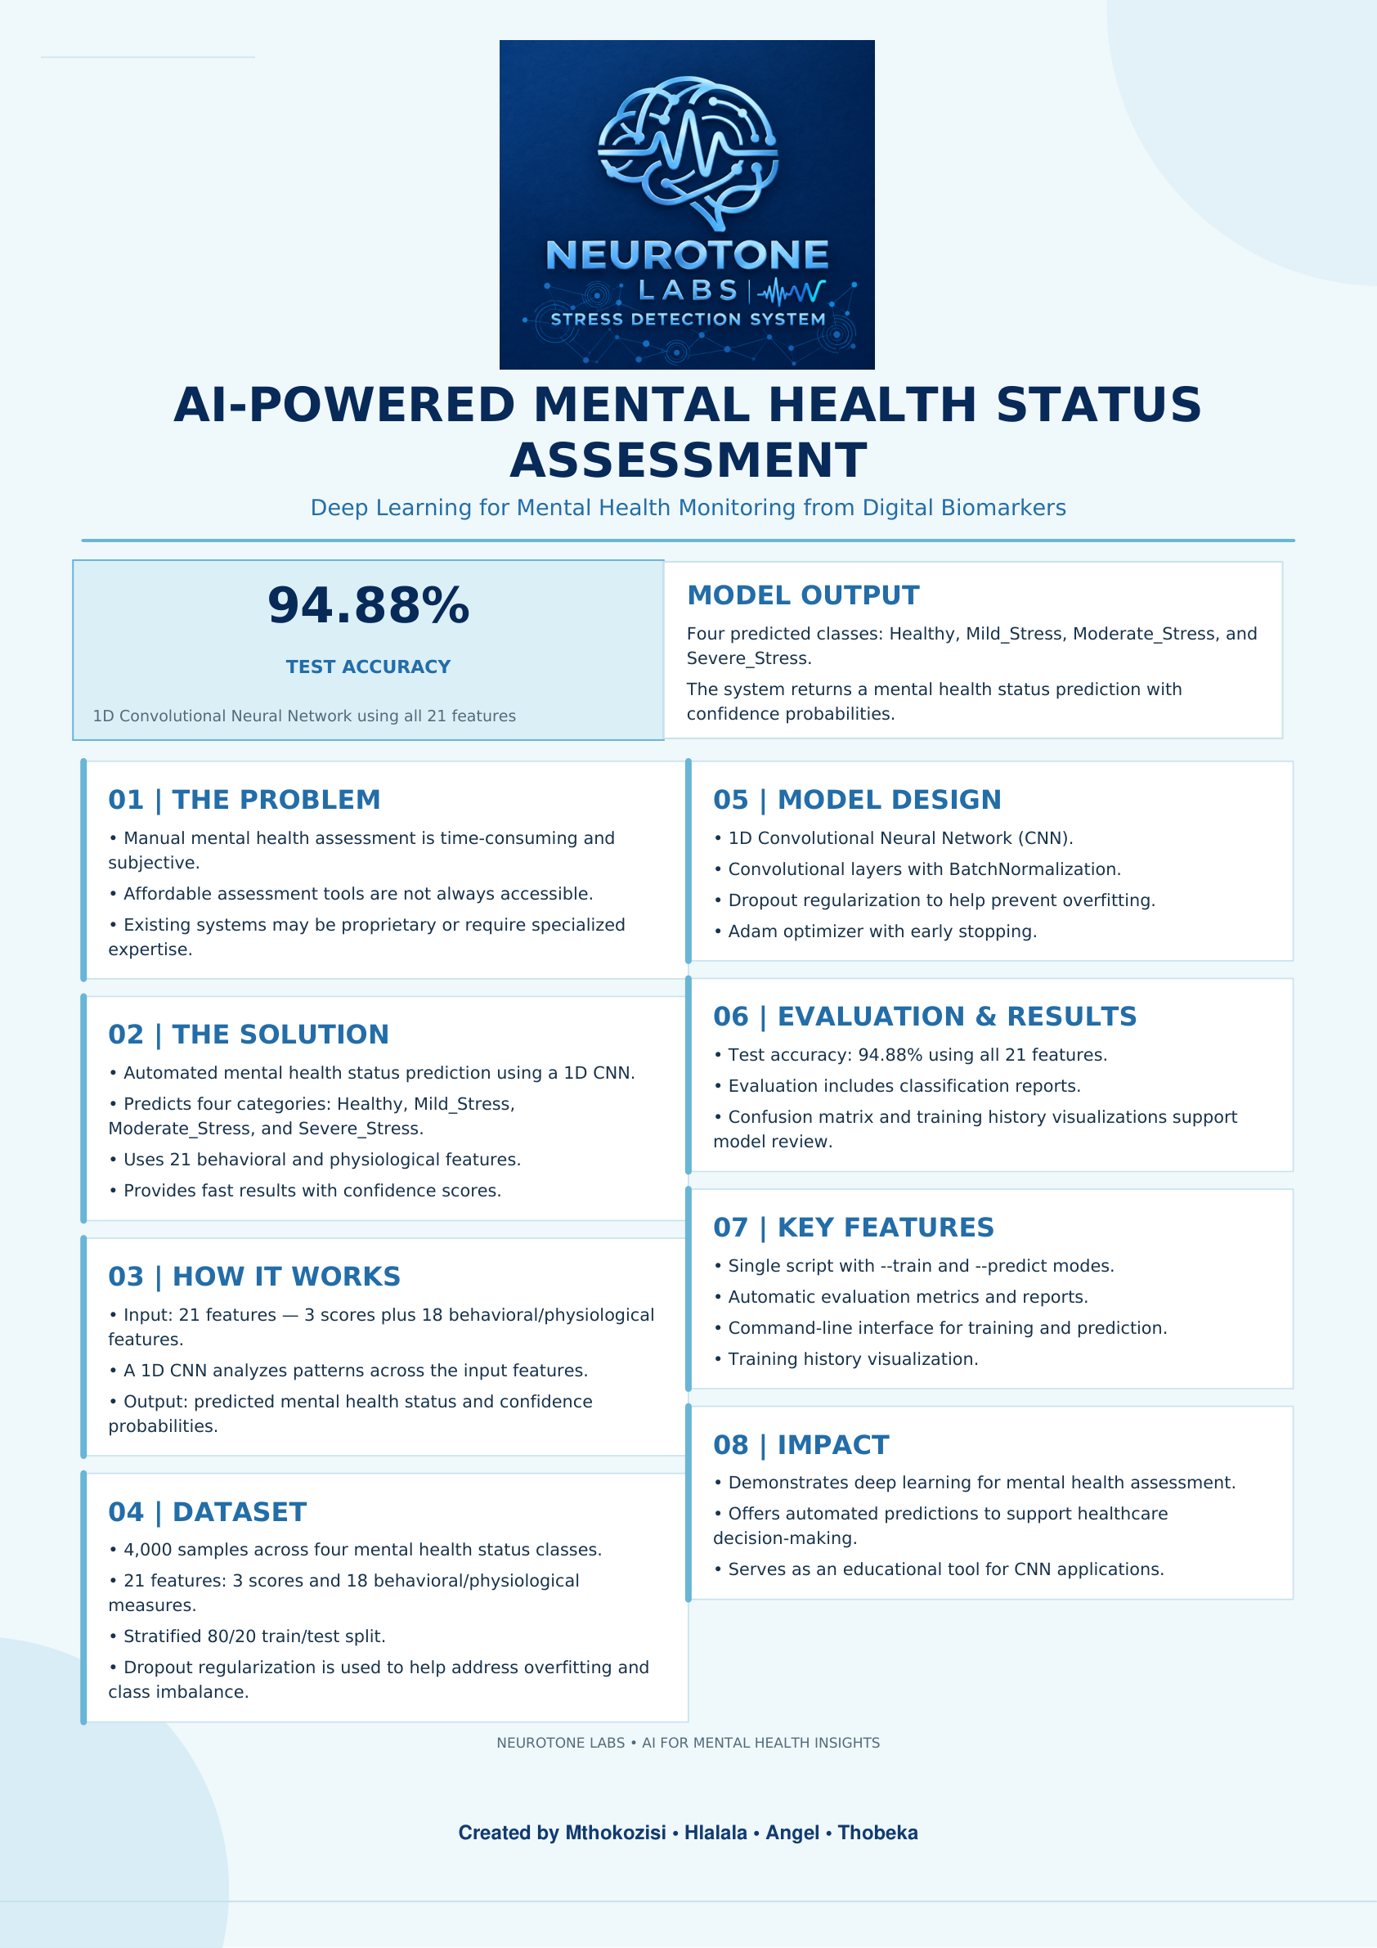
PROJECT POSTER • NEUROTONE LABS

Slide 14
PRACTICAL IMPLEMENTATION
Implementation: script purpose and usage
The submitted script describes two modes: --train to train the CNN and --predict to load the trained model and predict a selected CSV row.
The dataset path is configured as dataset/mental_health_multimodal.csv.
The prediction command supports selecting a row using the --row argument.
The script documentation states that row numbers refer to original CSV row numbers (1-based).
13 • NEUROTONE LABS

Slide 15
PRACTICAL IMPLEMENTATION
Implementation: data preparation
The code imports Python libraries including NumPy, pandas, TensorFlow, Matplotlib, and scikit-learn.
It sets random seeds for reproducibility.
It defines configuration values such as a 20% test split, validation split, maximum epochs, batch size, and early-stopping patience.
It cleans CSV column names, checks that the target and required features exist, and removes rows with missing target labels.
14 • NEUROTONE LABS

Slide 16
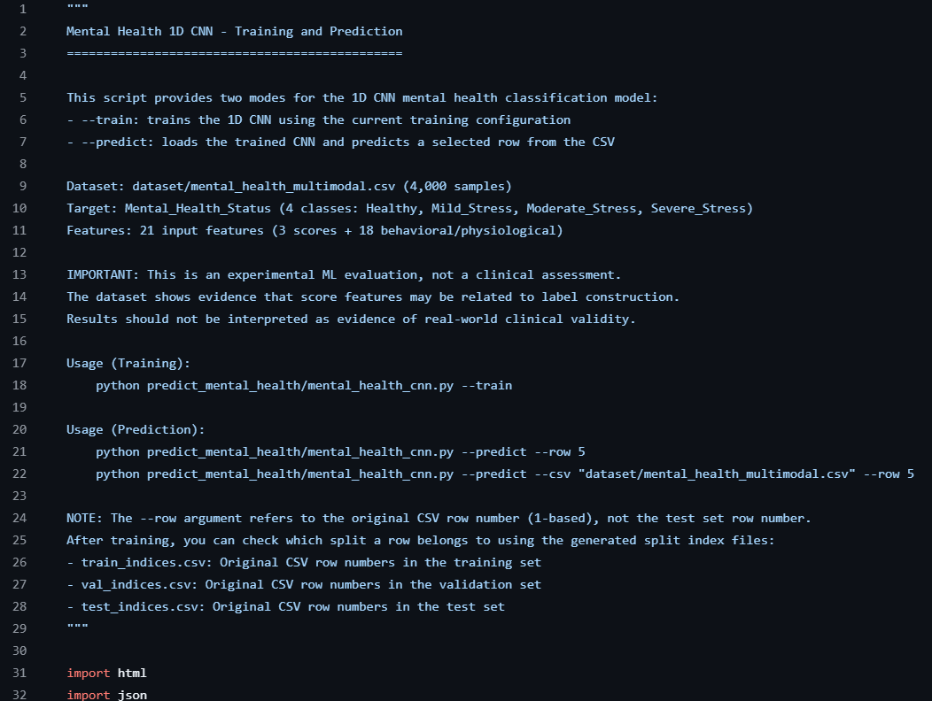
CODE EVIDENCE
Code screenshot 1 — script overview
Script documentation: training/prediction modes, dataset, target classes, feature count, and example commands.
15 • NEUROTONE LABS

Slide 17
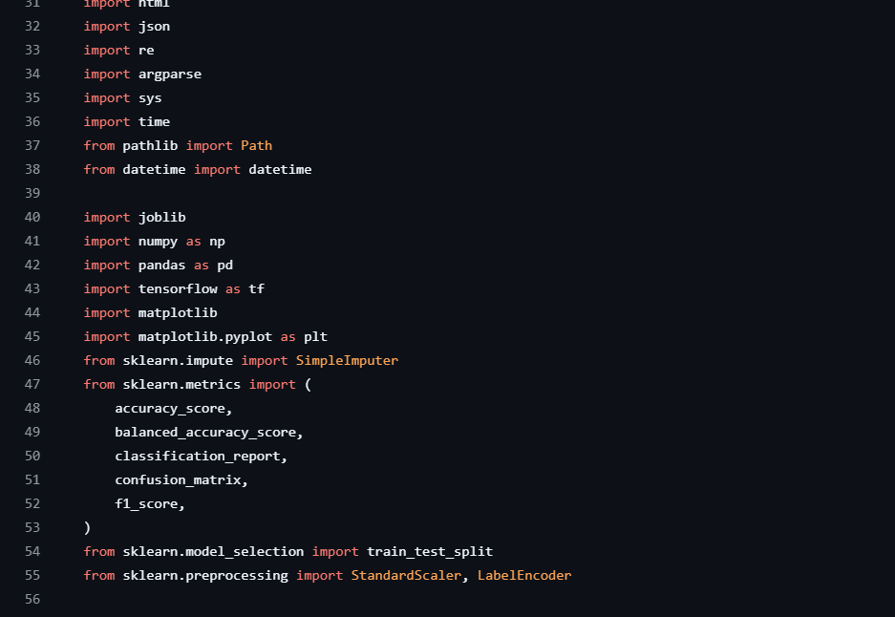
CODE EVIDENCE
Code screenshot 2 — imports and libraries
Imports for data handling, TensorFlow, plotting, preprocessing, model evaluation, and train/test splitting.
16 • NEUROTONE LABS

Slide 18
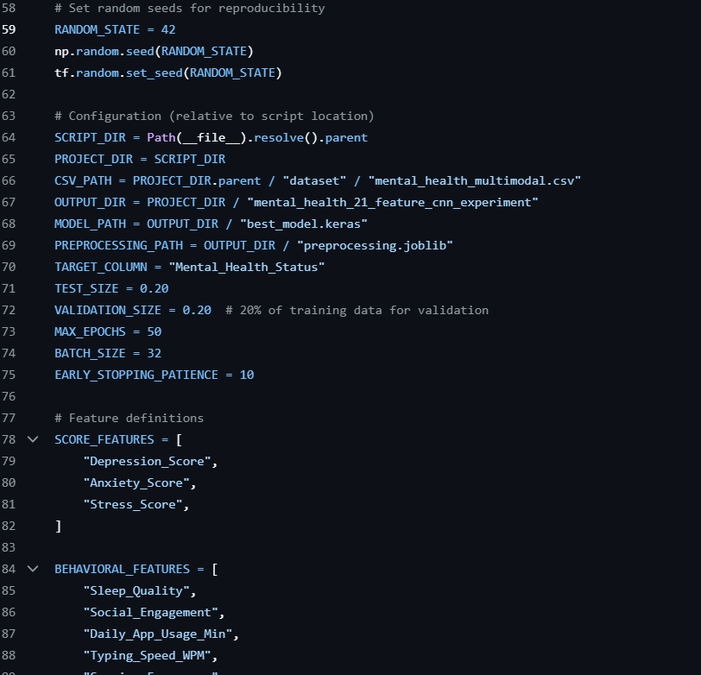
CODE EVIDENCE
Code screenshot 3 — configuration and features
Reproducibility settings, file paths, split configuration, training parameters, and feature definitions.
17 • NEUROTONE LABS

Slide 19
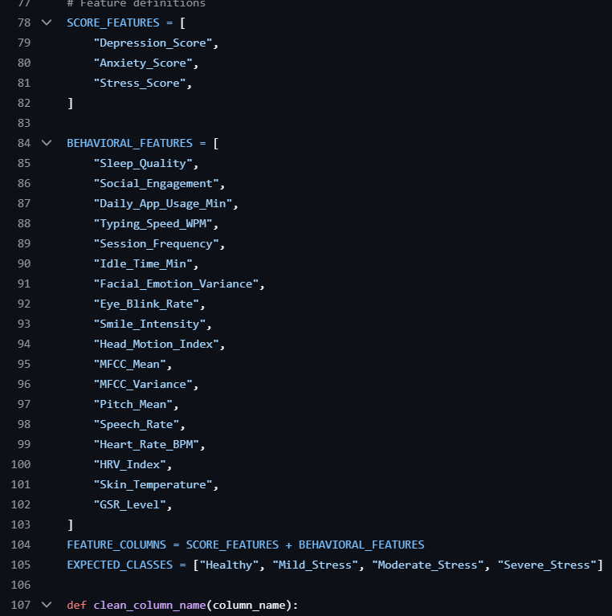
CODE EVIDENCE
Code screenshot 4 — feature definitions
The three score features and the list of behavioral and physiological input features.
18 • NEUROTONE LABS

Slide 20
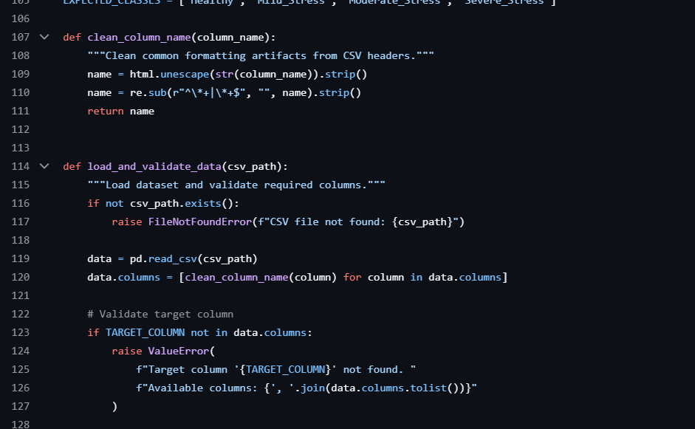
CODE EVIDENCE
Code screenshot 5 — data loading and validation
Column-name cleaning, dataset loading, and validation of the target and required feature columns.
19 • NEUROTONE LABS

Slide 21
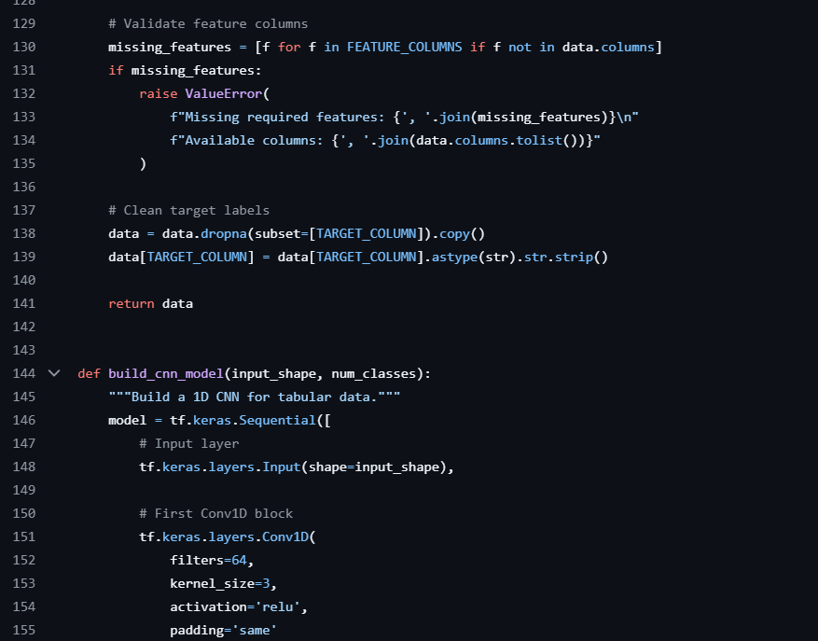
CODE EVIDENCE
Code screenshot 6 — CNN architecture
The visible model-building function and first convolutional block.
20 • NEUROTONE LABS

Slide 22
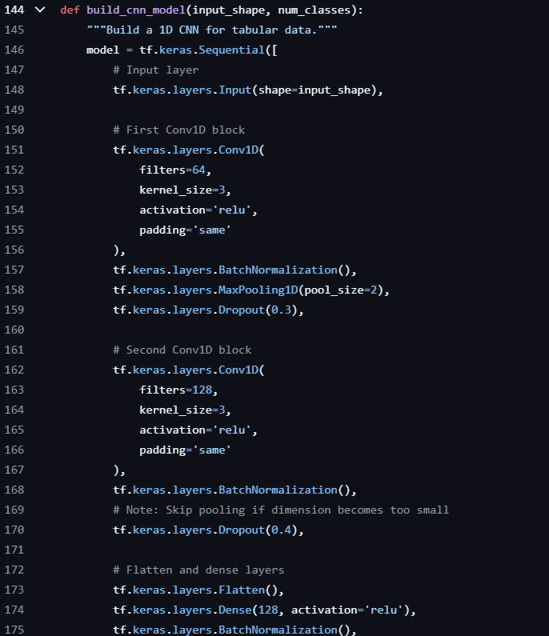
CODE EVIDENCE
Code screenshot 7 — CNN architecture continued
Continuation showing Conv1D blocks, batch normalization, max pooling, dropout, flattening, and dense layers.
21 • NEUROTONE LABS

Slide 23
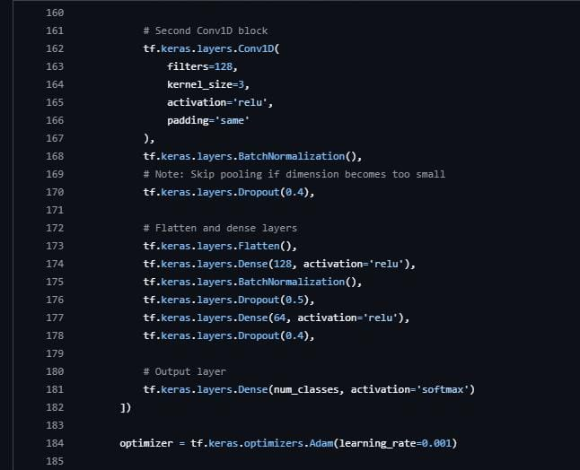
CODE EVIDENCE
Code screenshot 8 — CNN architecture and compilation
Continuation of the CNN layers, followed by model compilation with the Adam optimizer and categorical cross-entropy loss.
22 • NEUROTONE LABS

Slide 24
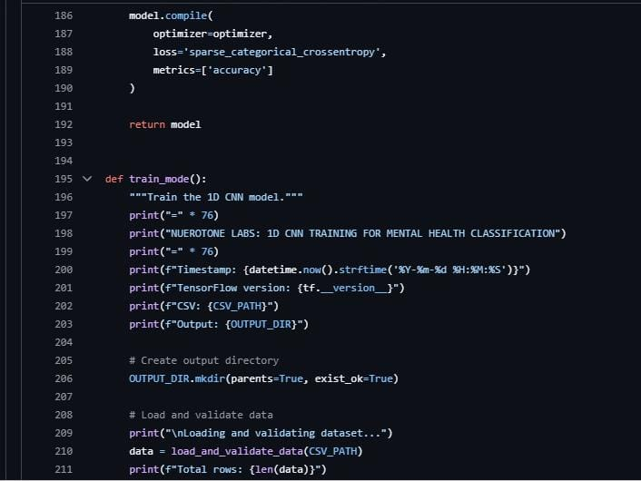
CODE EVIDENCE
Code screenshot 9 — Training mode and data loading
The training function creates the output directory, loads the dataset, and begins the training workflow.
23 • NEUROTONE LABS

Slide 25
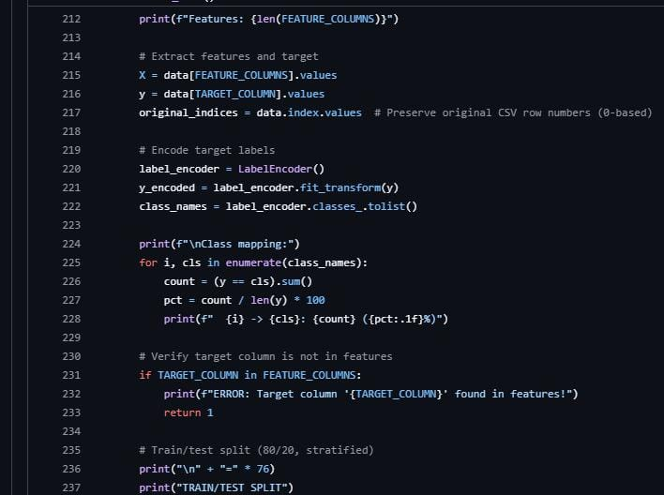
CODE EVIDENCE
Code screenshot 10 — Feature extraction and label encoding
The script extracts input features and the target column, preserves original row indices, and encodes the class labels.
24 • NEUROTONE LABS

Slide 26
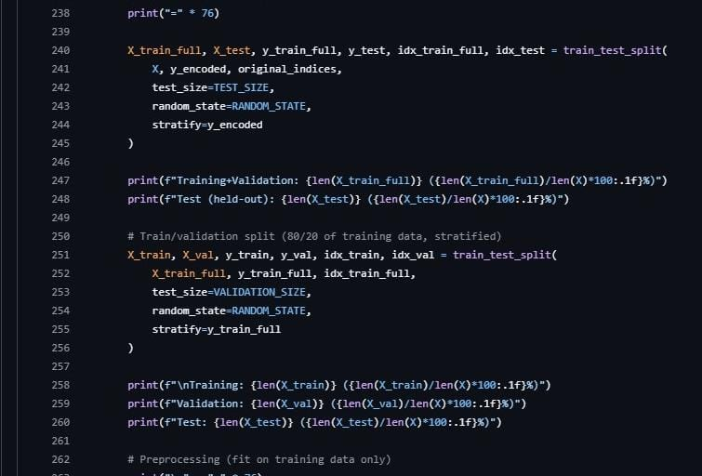
CODE EVIDENCE
Code screenshot 11 — Training, validation and test split
The dataset is split into training, validation and test sets using stratification to preserve class distribution.
25 • NEUROTONE LABS

Slide 27
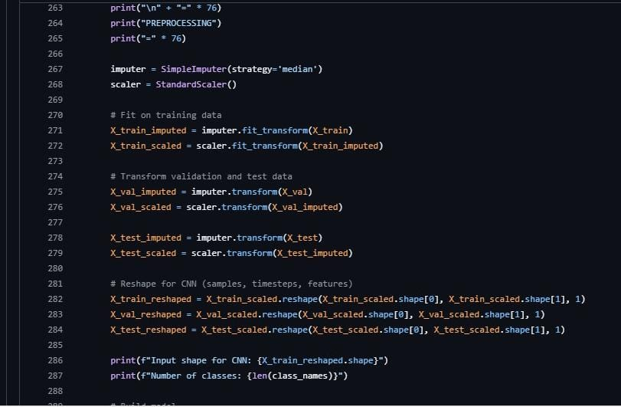
CODE EVIDENCE
Code screenshot 12 — Preprocessing and CNN input shape
Median imputation and standardization are fitted on training data, then applied to validation and test data before reshaping for the CNN.
26 • NEUROTONE LABS

Slide 28
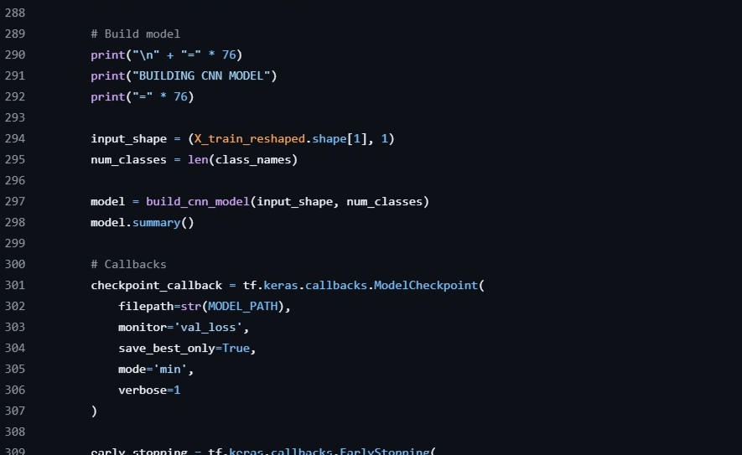
CODE EVIDENCE
Code screenshot 13 — CNN model setup and checkpoint
Lines 288–309: configure the CNN input, build the model, and set up model checkpointing.
27 • NEUROTONE LABS

Slide 29
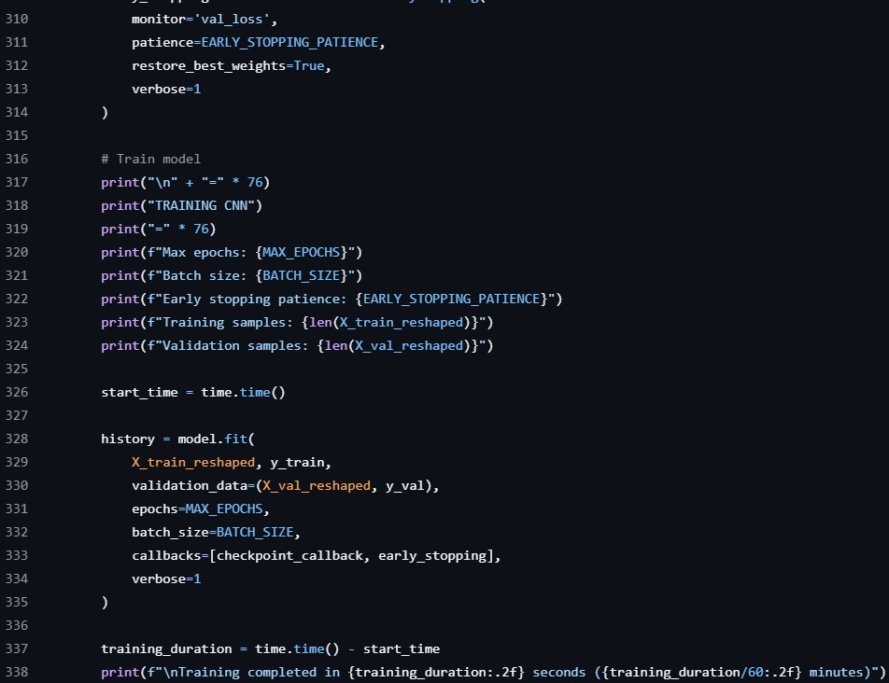
CODE EVIDENCE
Code screenshot 14 — CNN training loop
Lines 310–338: early stopping, model.fit(), and training-duration tracking.
28 • NEUROTONE LABS

Slide 30
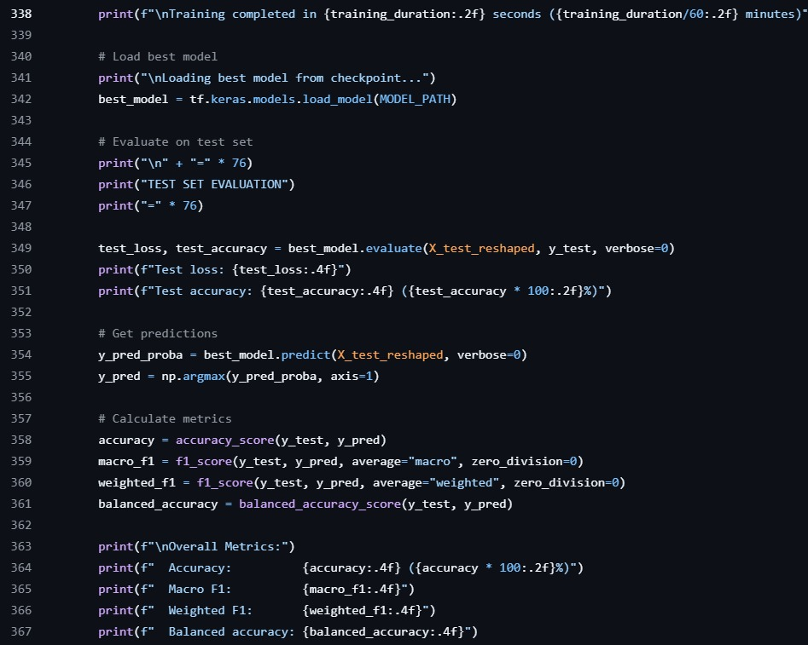
CODE EVIDENCE
Code screenshot 15 — Test set evaluation
Lines 338–367: Evaluate the best saved model and calculate test-set performance metrics.
29 • NEUROTONE LABS

Slide 31
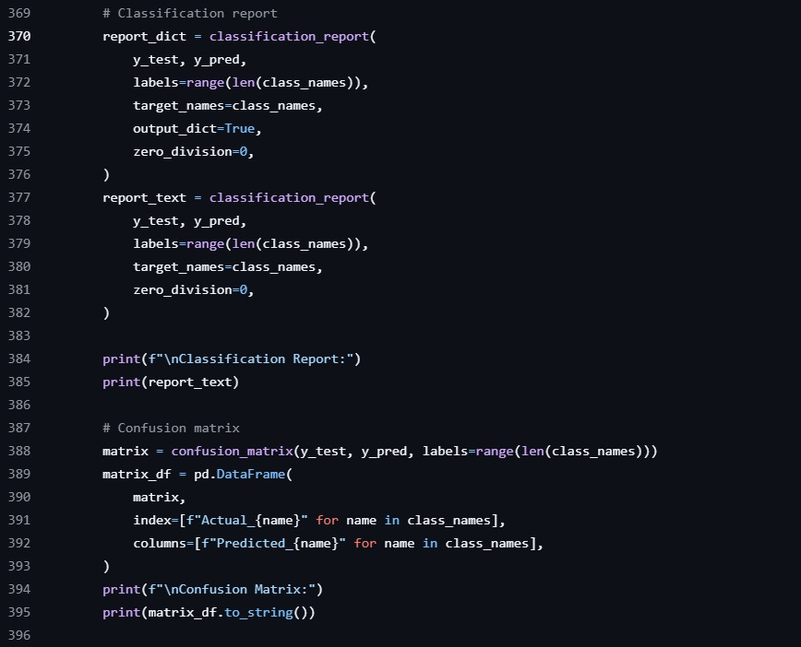
CODE EVIDENCE
Code screenshot 16 — Classification report
Lines 369–395: Generate per-class metrics and the confusion matrix.
30 • NEUROTONE LABS

Slide 32
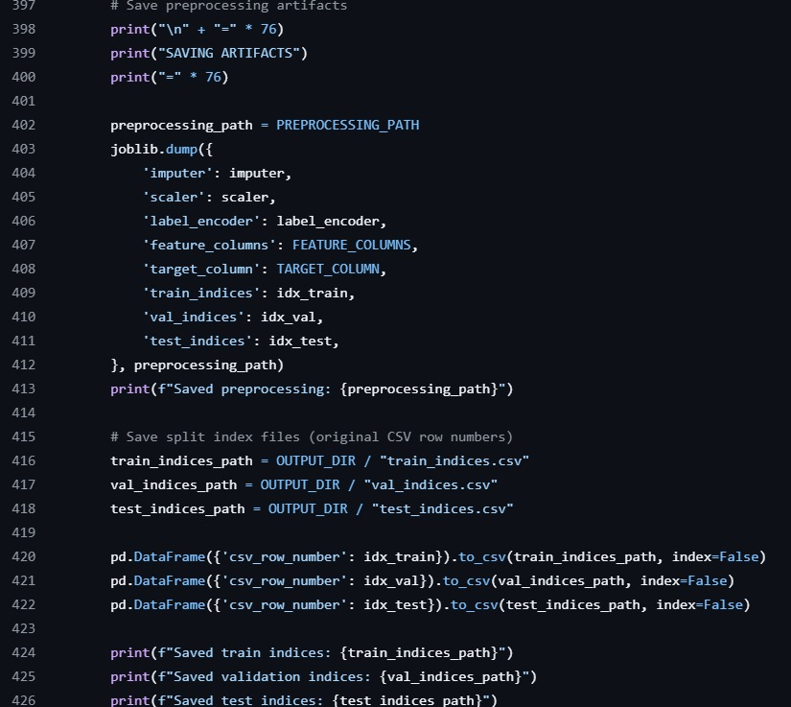
CODE EVIDENCE
Code screenshot 17 — Saving preprocessing artifacts
Lines 397–426: Save preprocessing components and the train, validation, and test row indices.
31 • NEUROTONE LABS

Slide 33
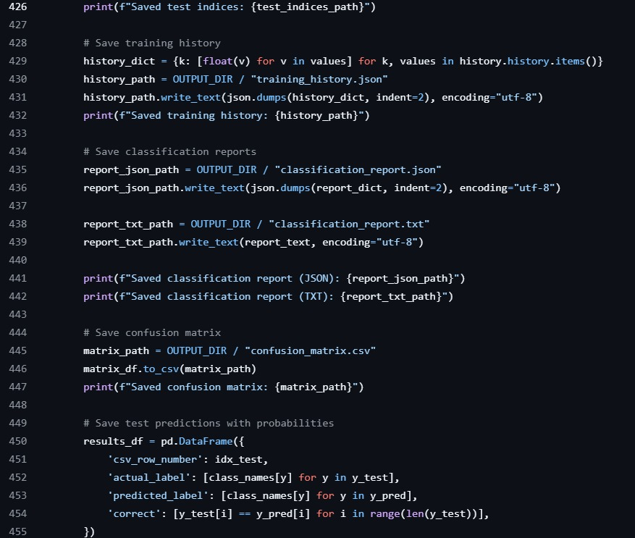
CODE EVIDENCE
Code screenshot 18 — Saving training history and reports
Lines 426–455: Save training history, classification reports, and confusion-matrix output.
32 • NEUROTONE LABS

Slide 34
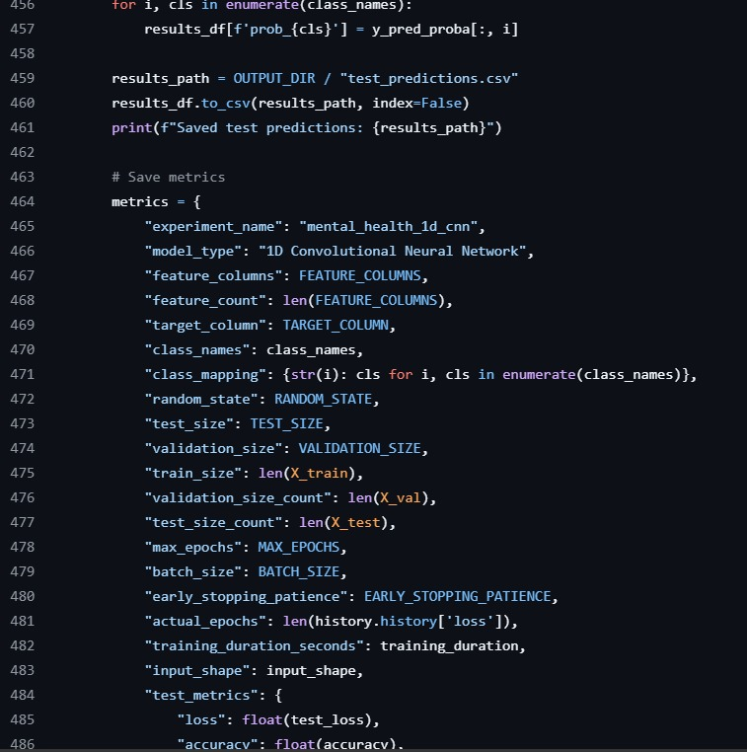
CODE EVIDENCE
Code screenshot 19 — Saving test predictions
Lines 456–486: Export test-row identifiers, actual and predicted labels, correctness, and class probabilities.
33 • NEUROTONE LABS

Slide 35
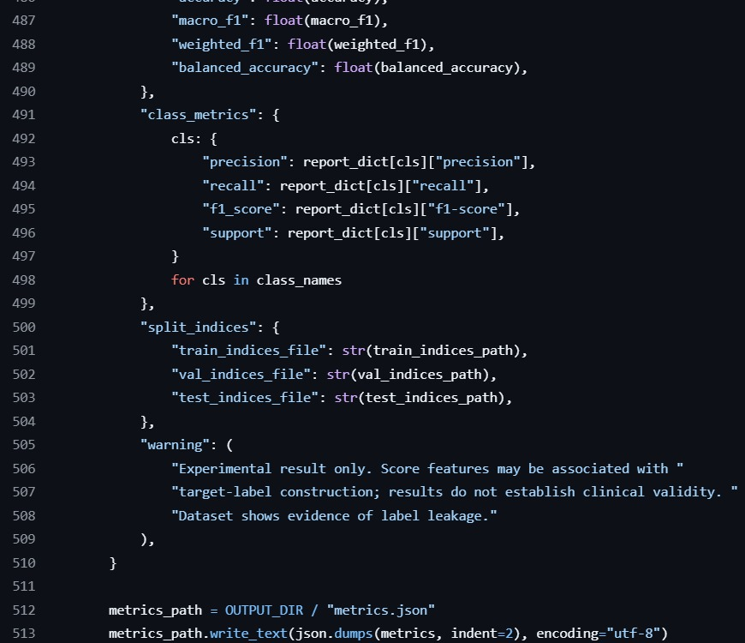
CODE EVIDENCE
Code screenshot 20 — Saving metrics
Lines 487–513: Record experiment settings, dataset split sizes, training duration, and test metrics.
34 • NEUROTONE LABS

Slide 36
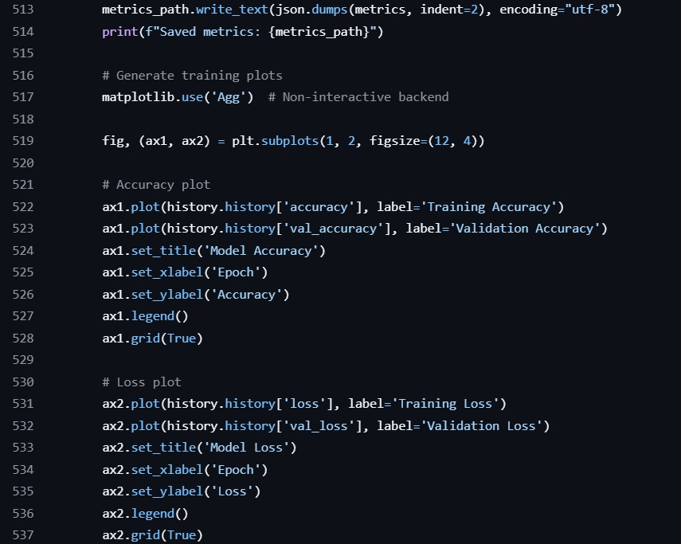
CODE EVIDENCE
Code screenshot 21 — Training accuracy and loss plots
Lines 513–537: generate training/validation accuracy and loss plots.
35 • NEUROTONE LABS

Slide 37
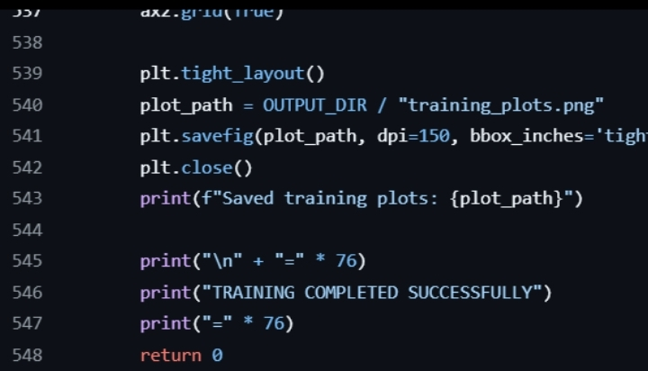
CODE EVIDENCE
Code screenshot 22 — Training completion and plot saving
Lines 537–548: Finish saving the training plots and report successful completion of training.
36 • NEUROTONE LABS

Slide 38
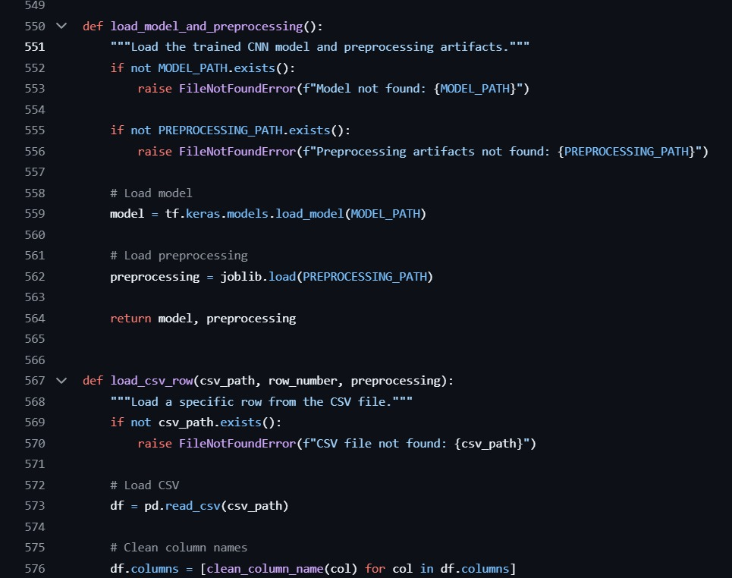
CODE EVIDENCE
Code screenshot 23 — Loading model and preprocessing
Lines 550–576: Load the saved CNN and preprocessing artifacts, then begin the CSV-row loading workflow.
37 • NEUROTONE LABS

Slide 39
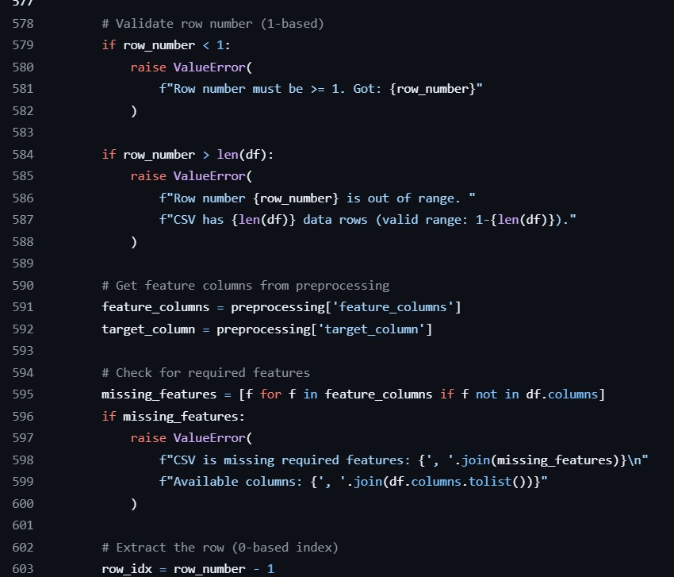
CODE EVIDENCE
screenshot 24 — Validating a selected rowCode
Lines 577–601: Validate the 1-based row number and check required CSV feature columns.
38 • NEUROTONE LABS

Slide 40
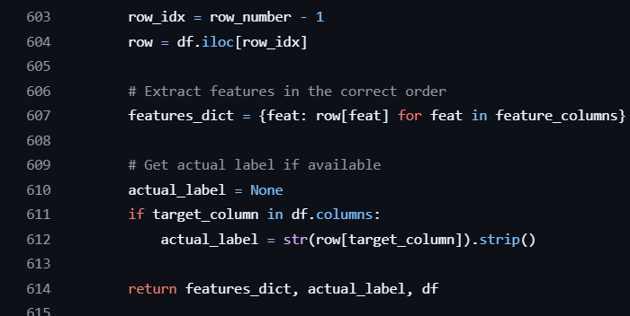
CODE EVIDENCE
Code screenshot 25 — Extracting row features
Lines 603–614: Read the selected CSV row, collect features in the required order, and retrieve its label when available.
39 • NEUROTONE LABS

Slide 41
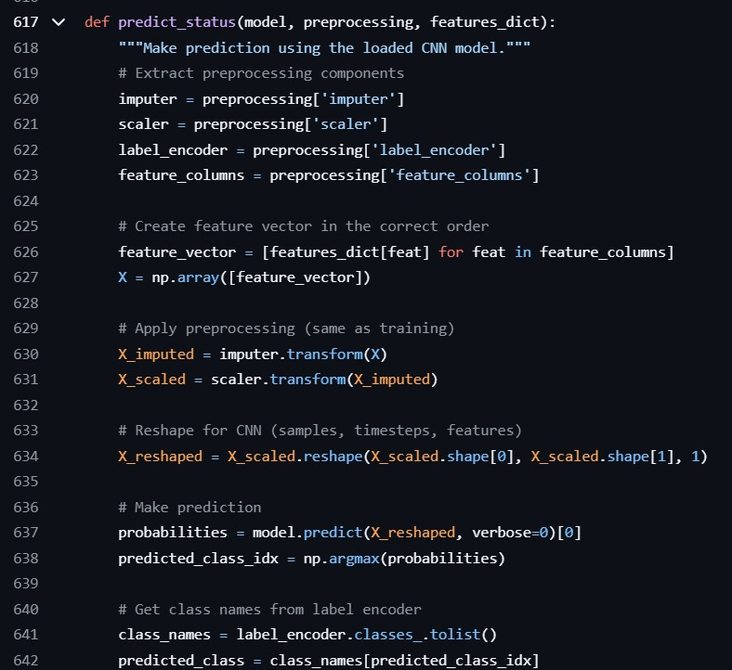
CODE EVIDENCE
Code screenshot 26 — Prediction preprocessing
Lines 617–642: Apply saved preprocessing and obtain CNN class probabilities for the selected input.
40 • NEUROTONE LABS

Slide 42
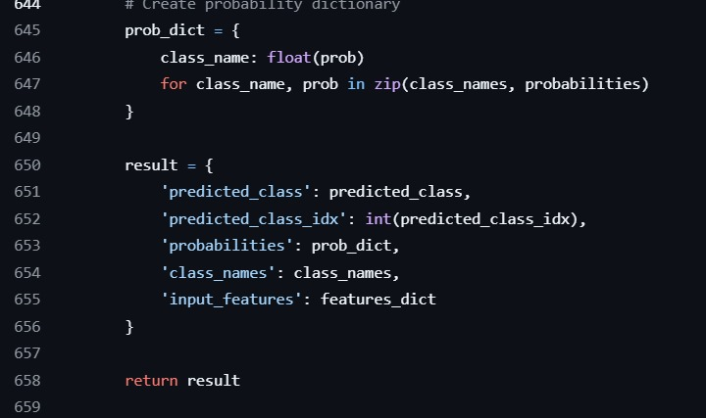
CODE EVIDENCE
Code screenshot 27 — Preparing prediction output
Lines 644–658: Package the predicted class, class index, class probabilities, class names, and input features.
41 • NEUROTONE LABS

Slide 43
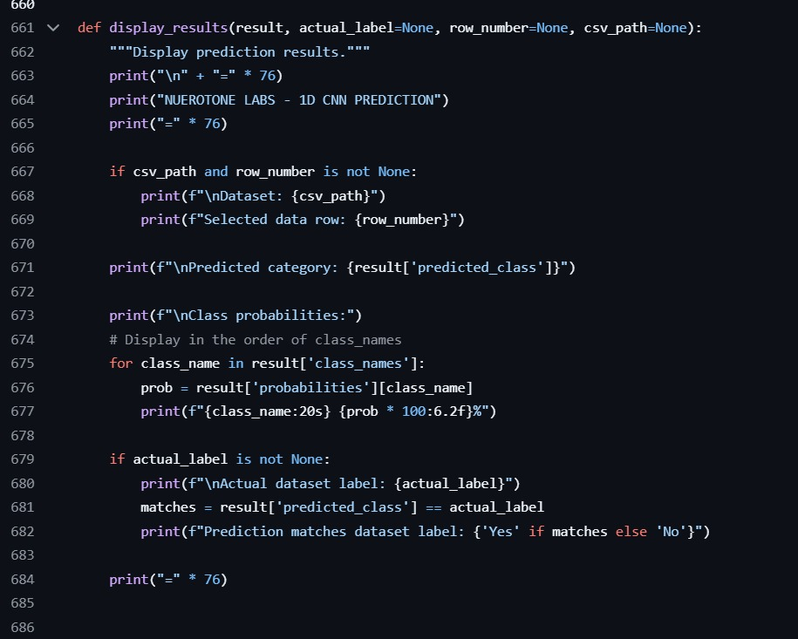
CODE EVIDENCE
Code screenshot 28 — Displaying prediction results
Lines 660–684: Display the predicted category, class probabilities, and optional comparison with the dataset label.
42 • NEUROTONE LABS

Slide 44
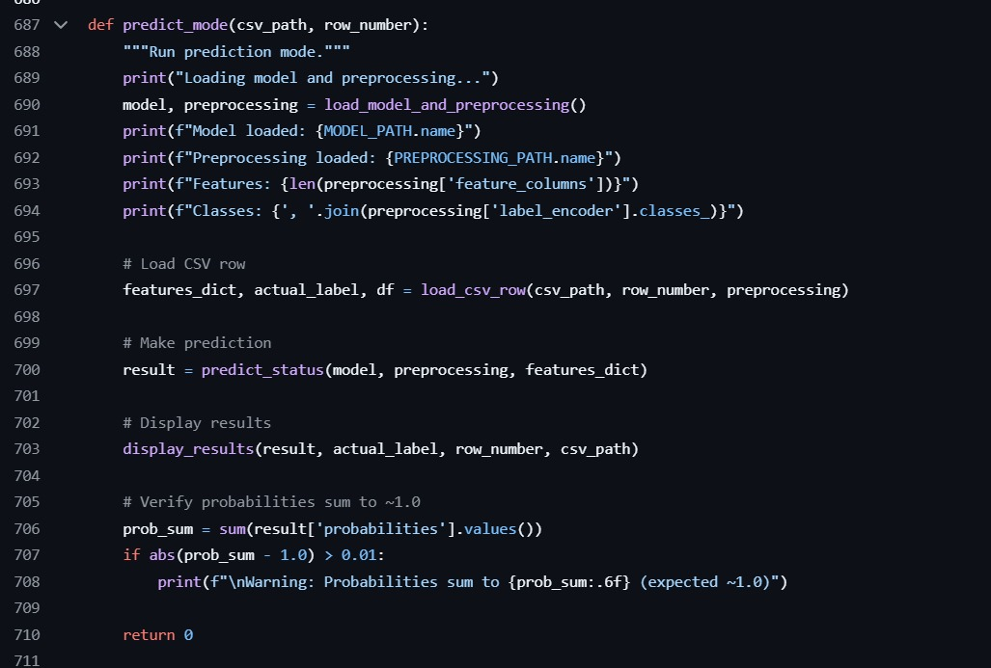
CODE EVIDENCE
Code screenshot 29 — Prediction mode
Lines 687–710: Load the model and preprocessing, run a selected-row prediction, and verify class probabilities.
43 • NEUROTONE LABS

Slide 45
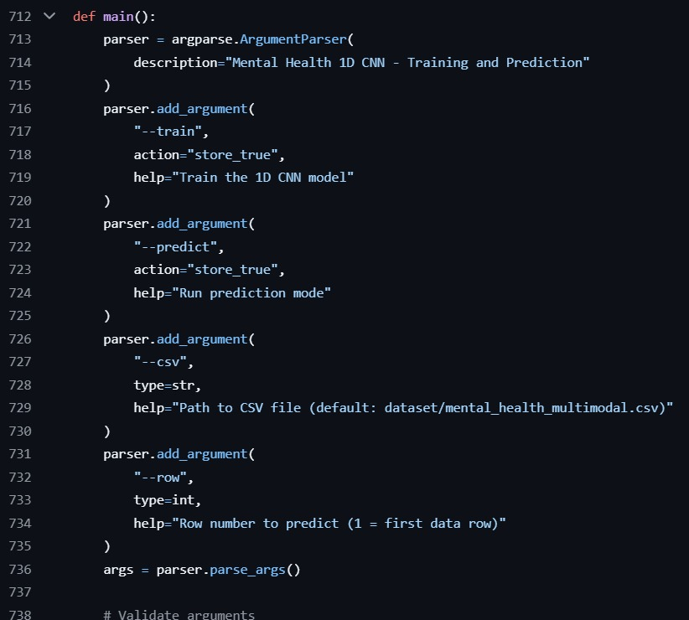
CODE EVIDENCE
Code screenshot 30 — Command-line arguments
Lines 712–738: Define the command-line interface for training and prediction, including CSV and row arguments.
44 • NEUROTONE LABS

Slide 46
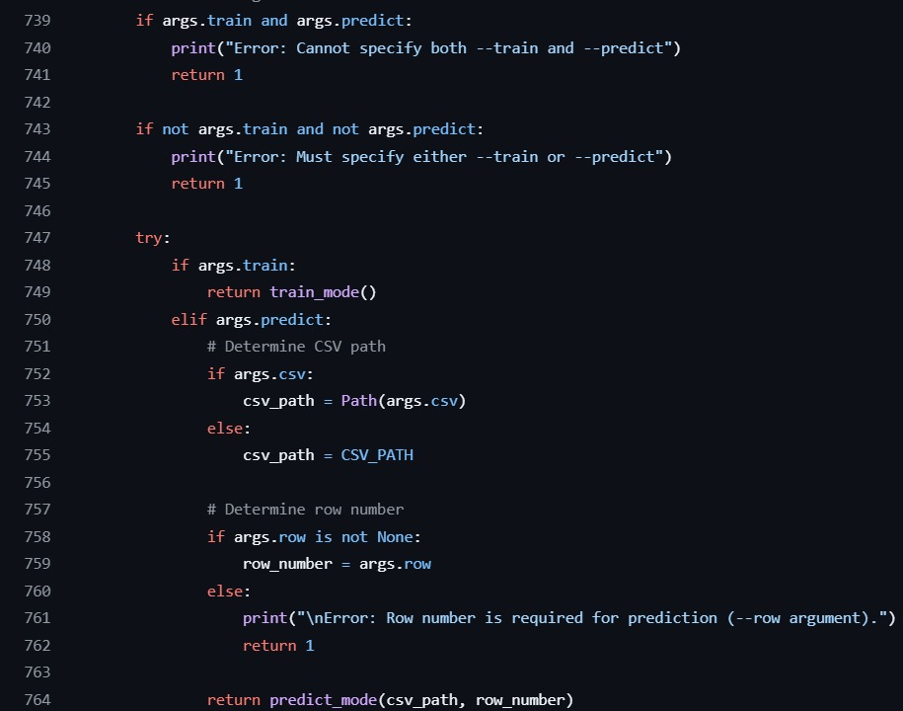
CODE EVIDENCE
Code screenshot 31 — Argument validation and execution
Lines 739–764: Validate the selected mode and route execution to training or row-level prediction.
45 • NEUROTONE LABS

Slide 47
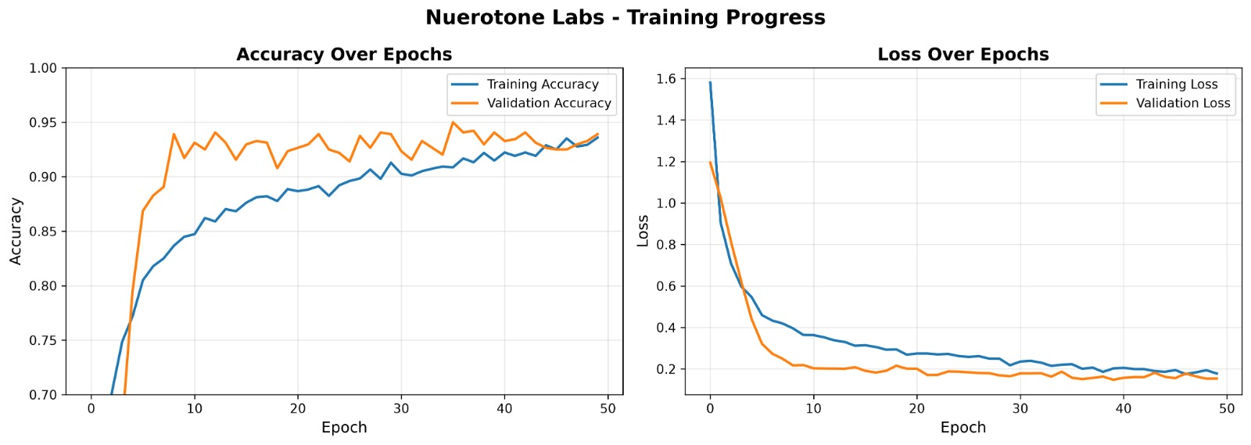
46 • NEUROTONE LABS

Slide 48
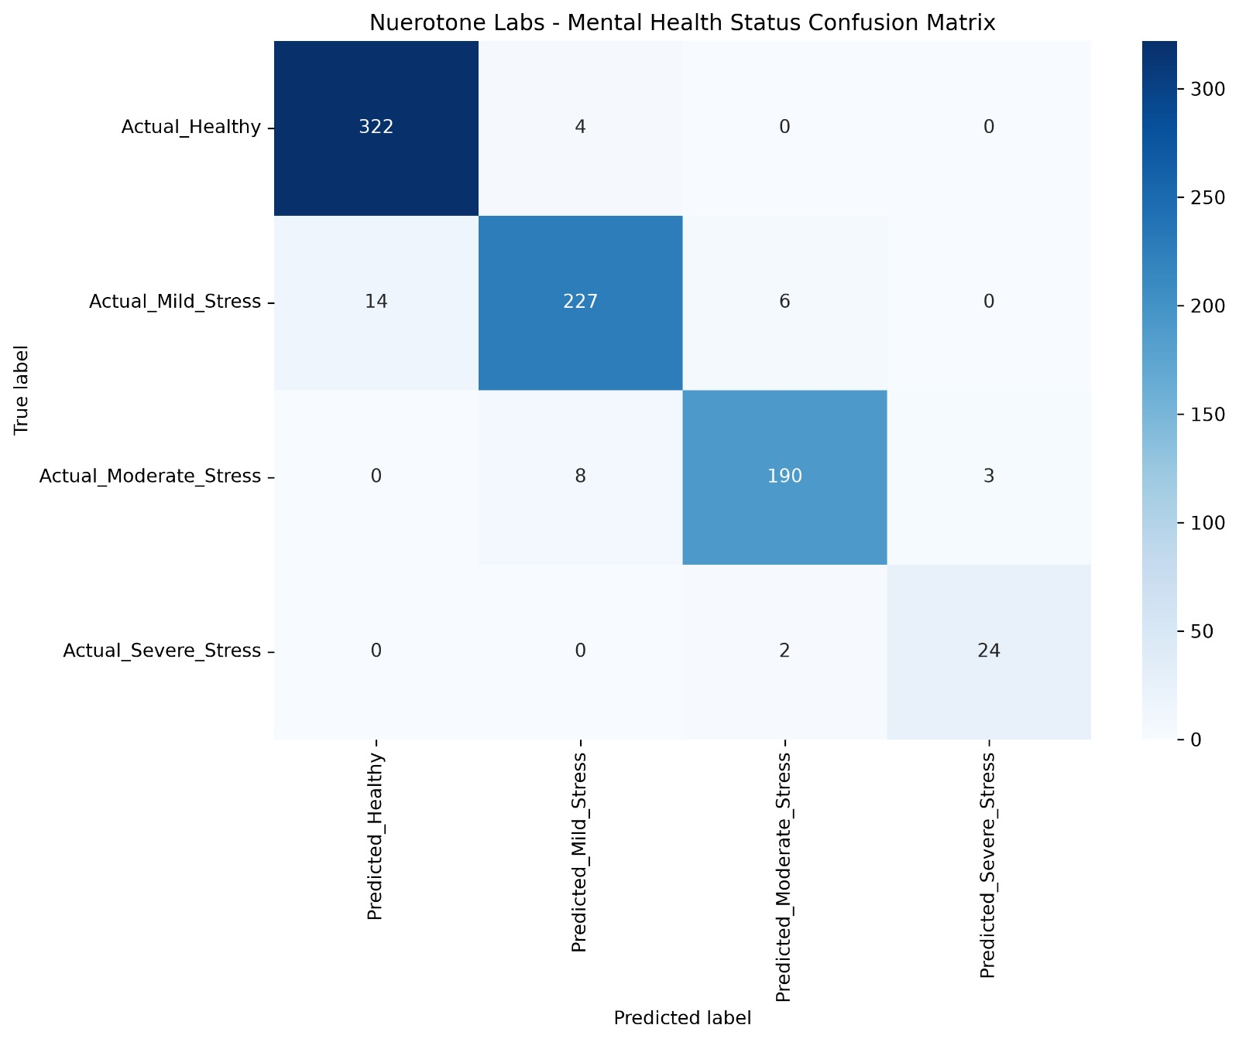
CONFUSION MATRIX
HEALTHY (326 samples)
322 correctly predicted (98.8%)
4 misclassified as Mild_Stress (1.2%)
No confusion with higher stress levels
MILD_STRESS (247 samples)
227 correctly predicted (91.9%)
14 misclassified as Healthy (5.7%)
6 misclassified as Moderate_Stress (2.4%)
MODERATE_STRESS (201 samples)
190 correctly predicted (94.5%)
8 misclassified as Mild_Stress (4.0%)
3 misclassified as Severe_Stress (1.5%)
SEVERE_STRESS (26 samples)
24 correctly predicted (92.3%)
2 misclassified as Moderate_Stress (7.7%)
47 • NEUROTONE LABS

Slide 49
RESULTS
Reported evaluation result
The supplied project poster reports a test accuracy of 94.88% using all 21 features.
The poster states that evaluation includes classification reports, a confusion matrix, and training-history visualizations.
The presentation materials describe confidence probabilities for all four predicted classes.
The detailed metric tables and plots have not yet been supplied for inclusion in this draft.
46 • NEUROTONE LABS

Slide 50
CONCLUSION
Conclusion and current draft status
The project demonstrates a 1D CNN workflow for classifying four mental health status labels from structured features.
The presentation now includes the supplied training and prediction code evidence.
The code evidence is arranged in execution order and ends before the results and conclusion.
The model is intended as an experimental decision-support/learning tool, not a diagnostic system.
The model remains an experimental learning and decision-support tool, not a diagnostic system.
47 • NEUROTONE LABS

